Slide 1
Energy Generation in Stars

Slide 2
Stellar Structure and Central Temperature
We can determine another property of stars by using a model of Stellar Structure.
The basic principle is that stars are in
Hydrostatic Equilibrium

Slide 3
Hydrostatic Equilibrium
At each radius
P_{grav}=P_{thermal}
As the weight of
Overlying material
Goes up, the
Temperature needs
To go up to keep
To pressure balance

Slide 4
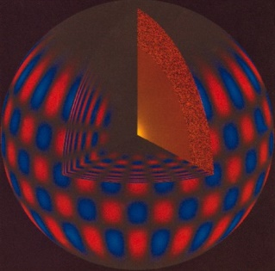
The Structure of the Sun
Build a model of the Sun in hydrostatic equilibrium and you will predict the Temperature and Density as a function of radius. You need to have a relationship between pressure, temperature and density -- this is called the Equation of State.
The first stellar structure models were constructed in the late 1950s.

Slide 5
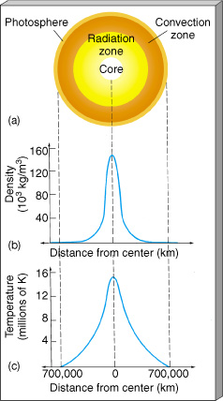
Solar Model
Hydrostatic models for the Sun predict the central temperature to be about 16 x 10⁶K.
On Earth this temperature has been reached is when H-bombs were exploded.

Slide 6
Energy Source for Stars
A really good question is `how do stars produce all that luminous energy’.
The answer should also naturally explain the main-sequence and the mass-luminosity relation.
Let’s start with the Sun. Requirements are:
(1) L= 4x10³³ ergs/sec
(2) for ~ 4.5 billions years

Slide 7
Coal or Wood Burning
What is `burning’? The conversion of molecular binding energy into heat.
Coal burning efficiency: 4 x 10¹²ergs/gram
A 3 kg bucket of coal will generate
1.2 x 10¹⁶ ergs = 300 kilowatt-hrs
which would power a 100 watt light bulb for 125 days.

Slide 8
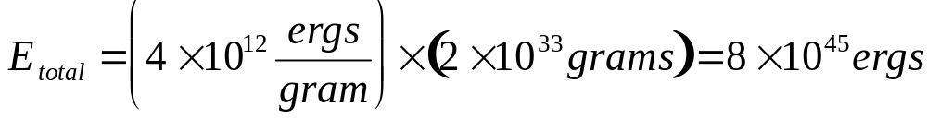
Coal Burning
Suppose all 2 x 10³³grams of the Sun are coal. The total energy you could generate would be:
That’s a lot of energy! At the rate of L_{o}, how long would the Sun last?

Slide 9
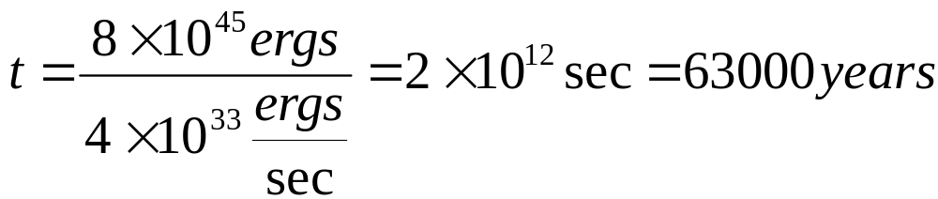
Coal Burning Lifetime
By the mid-1800s it was recognized that the Earth was at least millions of years old.
Note: L_{o} is equivalent to 1 ton of coal burned per second per square foot of the solar surface.

Slide 10
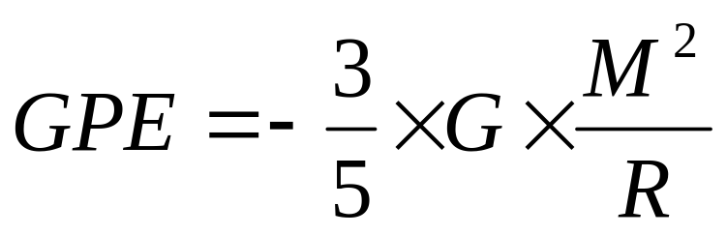
Gravitational Potential Energy
Anytime you have a collection of mass, there is associated gravitational potential energy (GPE). For a sphere of gas (like a star for example) the GPE is given by:
Where R is the radius of the sphere, M is the mass and G is the universal gravitational constant.

Slide 11
GPE
Imagine a large gas cloud that shrank in radius at constant mass.
Difference in GPE (actually 1/2 of it) must be released as E-M radiation during the shrinking.
Less GPE
Lots of GPE

Slide 12

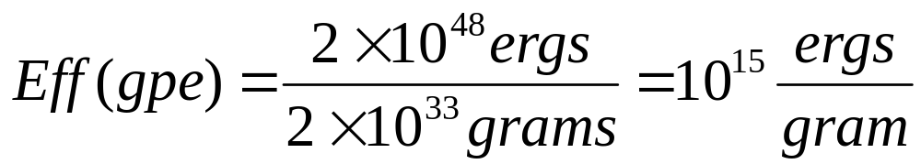
GPE efficiency
We can calculate the GPE of the Sun from the formula a few slides back:
If we could extract this amount of energy for radiation (by letting the Sun shrink) it would yield:

Slide 13
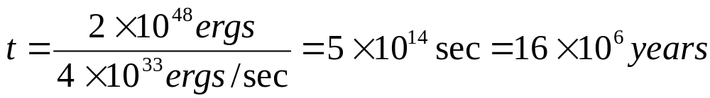
GPE
This is 250 times more efficient than chemical burning, but if you do the lifetime calculation again:
Still too short! (Plus the Sun would have to have been much larger in the past)

Slide 14
GPE
A variant of this method was considered a serious possibility until the early 1900s. Comets falling into the Sun would make a good energy source. Only need about 1 Earth mass per year. The mass of the Sun would be increasing, and there is no evidence from changes in the Earth’s orbit to support this idea.

Slide 15
Nuclear Power
The answer for the power source of the Sun had to await the discovery of the nucleus and the nuclear force.

Slide 16
Forces of Nature
(1) Gravity is an attractive force between objects with mass. This keeps keeps the Earth in orbit around the Sun, prevents the hot gases in the Sun from expanding away into space and other useful stuff.
This is the weakest of the fundamental forces.

Slide 17
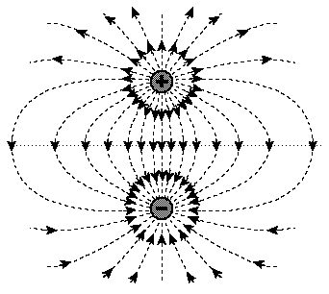
Forces of Nature
(2) Electric Force between electrically- charged objects (protons and electrons).
This is the force that holds atoms and molecules together and is useful for running nifty gadgets.
Chemical burning is converting electrical forces into E-M radiation.

Slide 18
Forces of Nature
(3) Weak Nuclear Force. This is responsible for radioactive decay of some nuclei.
(4) Strong Nuclear Force. This is an attractive force between nucleons and it is what binds protons and neutrons together in the nuclei of atoms

Slide 19
The Four Forces
Note that Gravity is MUCH weaker than the electric force or the strong nuclear force. Comparing the electric repulsion of two protons to their gravitational attraction, gravity is weaker by a factor of 10³⁶.
But Gravity dominates the Universe.

Slide 20

Energy from the Nuclear Force
There are two paths to deriving energy from nuclear reactions (a nuclear reaction is adding or subtracting a proton or neutron from a nucleus).
(1) Nuclear Fission
(2) Nuclear Fusion

Slide 21
Nuclear Fission
There are some elements in the Periodic Table that spontaneously fall apart. These are the radioactive elements.
Th²³⁴
#p + #n⁰
90
Gamma ray
U²³⁸
92
He⁴
2
#of protons (element)

Slide 22
Mass Defect
Even though there are the same number of nucleons before and after, a little mass disappeared in the reaction. This mass is associated with the difference in Nuclear Binding energy before and after.
The missing mass has been converted into energy.

Slide 23
E = mc²
In this application, `m’ is the mass that went missing and `E’ is the energy released in the form of gamma rays. For some fission reactions, the amount of energy released per gram of missing mass is large.

Slide 24
Nuclear Fission
Fission can release as much as
10¹⁸ ergs/gram
Recall, coal burning released
4 x 10¹² ergs/gram

Slide 25
Nuclear fission could produce enough energy to fuel the Sun for ~6 x 10¹⁰ years IF the Sun were composed completely of fissionable material.
It is not! For example, the Uranium abundance in the Sun is less than a millionth of the solar mass.

Slide 26
Nuclear Fusion
Imagine a gas of protons (p+). At `low’ temperatures the electrical repulsion force prevents the close approach of two p+
But as T increases, the minimum approach distance decreases and some p+ get close enough (10⁻¹⁵m) for the short-range, but VERY STRONG nuclear force to bind them together.

Slide 27
Hydrogen (proton) fusion
protons in a gas avoid `collisions’
p+
p+

Slide 28

Hydrogen (proton) fusion
However, as a gas temperature goes up, the average speed of the particles goes up and the protons get closer before repelling one
another. If the proton get very close, the short-range nuclear force
fuses them together.
p+
p+

Slide 29

Hydrogen Fusion
Proton fusion involves some interesting ideas.
One of the p+ emits a
Positron and becomes a nº
neutrino
Matter --antimatter
annihilation
positron

Slide 30
Hydrogen Fusion
When two protons fuse, almost immediately one turns into a neutron by emitting a positively charged electron (known as a positron and `beta-decay’). The e⁺ is antimatter (!) When it comes into contact with its matter partner (e⁻) it annihilates entirely into energy.
Deuterium Created (heavy hydrogen)

Slide 31
Neutrinos
Another curious particle that flies out of the reaction is called a `neutrino’ .
This is a chargeless, perhaps massless particle which has a tiny crossection for interaction with other types of matter. The mean free path in lead is five light years.
Neutrinos were first postulated in 1932 to account for missing angular momentum and energy in beta-decay reactions (when a proton becomes a neutron and emits a positron).
Neutrinos are leptons - subatomic particles that participate in weak interactions, but not the strong nuclear force.

Slide 32
Neutrinos
The Sun emits about 10³⁸ neutrinos/sec.
Humans emit about 3x10⁸ neutrinos/day (radioactive potassium).
Every second we have many neutrinos pass through our bodies: 400,000 billion from the Sun, 50 billion from the Earth and 100 billion from nuclear power plants.

Slide 33

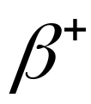
P-P Chain
10⁹years
H¹
H¹
He³
H¹
1 sec
He⁴
H¹
10⁶year
H¹
H¹
H¹
Gamma ray
H¹

Slide 34
P-P Chain
The net result is
4H¹ --> He⁴ + energy + 2 neutrinos
where the released energy is in the form of gamma rays.
The source of the energy is again a tiny bit of mass that goes missing:
Mass(4H) = 6.6943 x 10⁻²⁴ grams
Mass(He⁴) = 6.6466 x 10⁻²⁴ grams

Slide 35
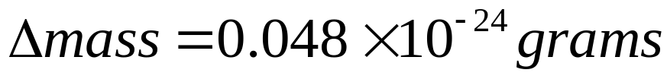
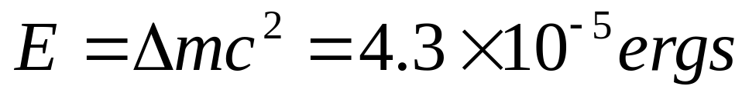
P-P Chain
The amount of missing mass is:
The energy generated is:
This much energy is released by 4H¹ with a total mass of 6.6943 x 10⁻²⁴grams. The efficiency of hydrogen fusion is therefore:
6.4 x 10¹⁸ ergs/gram

Slide 36
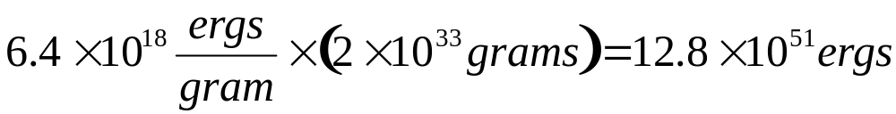
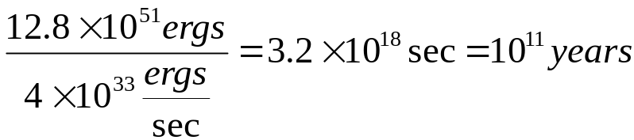
Sun’s Lifetime with H-fusion
Total energy available:
Lifetime of the fusion-powered Sun
This is promising!
100 billion years

Slide 37

Requirements for a Fusion-powered Sun
(1) Need lots of protons (H nuclei).
Element | Abundance (#)
Hydrogen | 92.0%
Helium | 8.3%
Oxygen | 0.06%
Carbon | 0.02%
Nitrogen | 0.01%
The rest | …

Slide 38
Requirements for Fusion-powered Sun
(2) Need a high temperature. For the p-p chain the gas temperature needs to be >10⁷K.
Recall the discussion about stellar structure. In the center of the Sun, hydrostatic equilibrium requires the temperature to be around 15 million K.

Slide 39
Fusion-powered Sun
Lots of fuel
Conditions are right in the central 10% for the P-P cycle to run
P-P fusion is efficient enough to power the Sun for billions of years.

Slide 40
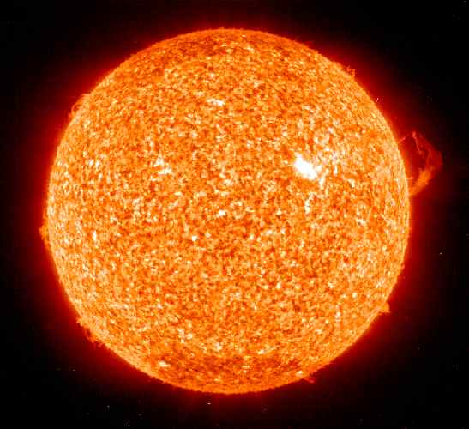
Looks like the Answer!
H -->He

Slide 41
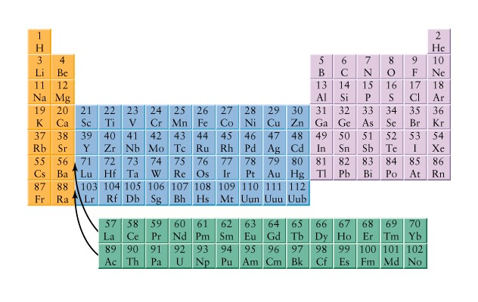

Slide 42
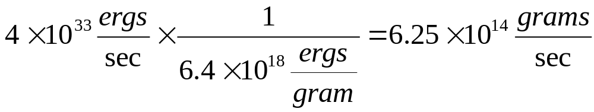
Fusion-powered Sun
An interesting aside. To produce the solar luminosity, the Sun is converting matter into energy:
This is the amount of H --> He per second. The amount of matter converted to energy is:
4.3 million tons per second

Slide 43
The Sun shines by converting mass into energy. Show that the Sun produces 3.78 x 10²⁶ J of energy per second by expending 4.2 million tons (4.2 x 10⁹ kg) of mass per second.

Slide 44
Assume the Sun has been producing energy at a contant rate over its lifetime of 4.5 billion years (1.4 x 10¹⁷ s).
a. How much mass has it lost creating energy over its lifetime?
b. The present mass of the Sun is 2 x 10³⁰ kg. What fraction of its mass has been converted into energy over the lifetime of the Sun?

Slide 45
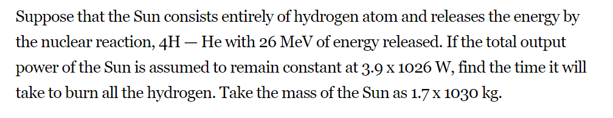

Slide 46
The Sun: Our nearest star
Property | Value
Surface T | 5500K
Central T | 15x10⁶ K
Luminosity | 2 x 10³³ ergs
Mass | 4 x 10³³ grams
Lifetime (ms) | 10 billion years

Slide 47
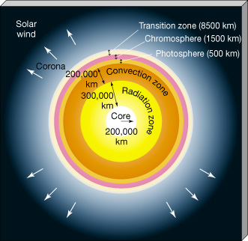
Solar Structure

Slide 48
Solar Neutrinos
Solar issue. Neutrinos.
Because they zoom straight from the center of the Sun where they are produced, neutrinos give us a picture of the center of the Sun.
Even though they are hard to catch, seemed worthwhile to attempt to count the Solar neutrinos and verify the solar models.

Slide 49
Solar Neutrinos
In the 1960s an experiment was set up to count solar neutrinos -- 1 out of every 10¹⁶ neutrinos that flow through a tank with 100,000 gallons of cleaning fluid turned a chlorine atom into an argon atom. Started counting and they came up short by about a factor of three.
This was the great Solar Neutrino Problem.

Slide 50
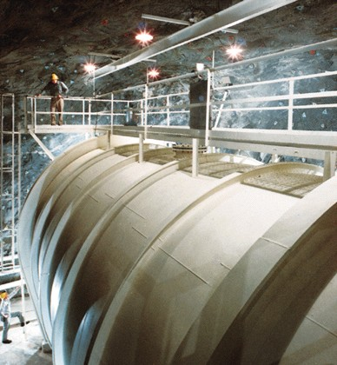

Slide 51
Discuss the "solar neturino problem" and how this problem was solved.
The problem is that the measured flux of neutrinos coming from the Sun is 1/3 that which is expected from the hydrogen burned in the Sun. Originally, the problem was thought to be with the model of the Sun, but recently we have discovered that the three types of neutrinos can interchange their identity, so some of the neutrinos from the Sun are turning into other types of neutrinos and the experiments are not sensitive to the other types of neutrinos.

Slide 52
The Main Sequence
Once the energy source of stars has been identified, it is easy to understand the main sequence in the H-R Diagram.
(1) More massive stars require higher central temperatures (hydrostatic eqm.)
(2) The P-P fusion rate and luminosity is proportional to T⁴
Therefore, more massive stars will have higher central temperature and higher Luminosity. This is what is seen along the H-R Diagram main sequence.

Slide 53
Philosophical Side Trip
There is an interesting implication of our understanding of how the Sun and other stars produce energy:
The Universe is changing: H ->He

Slide 54
Stellar Lifetimes
The Sun (and all stars) will eventually run out of fuel (hydrogen in regions where it is hot enough for fusion).
If all the hydrogen in the Sun could fuse to helium, the Sun’s lifetime would be 100 billion years.
But, by the time about 10% of the Sun’s H has been converted into He the solar structure will be changed and it will not be a main-sequence star.

Slide 55
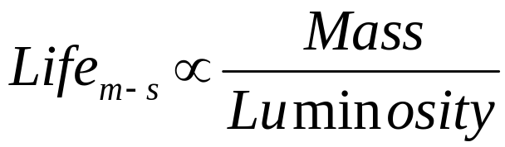
Stellar Lifetimes
The Sun has a main-sequence lifetime of 10 billion years. What about the other stars?
(1) The fuel for stars is mass
(2) The fuel consumption rate is Luminosity
So, it’s easy!

Slide 56
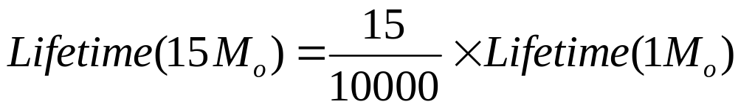
Example Stellar Lifetime
Suppose you have a 15M_{o} star with a luminosity of L=10,000L_{o}. How long will this star spend on the main sequence?
10,000 times L
decreases the
lifetime
15 times as much
fuel extends the life
of the star

Slide 57
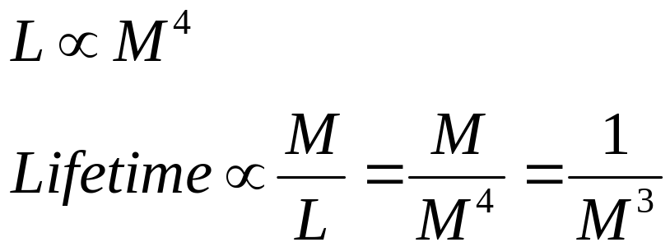
Stellar Lifetimes
Remember there was a Mass-Luminosity relation for the main sequence. This gives the mass-lifetime relationship:
Lifetimes range from a few million to 100 trillion years.

Slide 58
Lower Mass Limit for Stars
We call these objects `Brown Dwarfs’
We now can see why there is a lower limit for the mass of a star of about 0.08M_{o}.
For decreasing mass, the central temperature of a star decreases. At 0.08M_{o} the central temperature drops below 10 million k and it is too cool for P-P fusion!

Slide 59
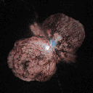
Upper Stellar Mass Limit
Eta Carina is a star of almost 100 solar masses.
Radiation pressure is blasting off the outer parts.

